Slide 1
A Recommender Systems for; 1) Idea of opening new Restaurant 2) Best area suggestion to contractor for opening new business.
Applied Data Science Capstone Project
PALLAVI VISHWANATH KULKARNI

Slide 2

Use Case : A Recommender System for Best area to open new Restaurant and New Business

Slide 3
Introduction and Business problem :
This project is about finding the best neighborhoods in the city of Toronto to open a new restaurant of a specific type (for example : Chinese, or Italian restaurant).
This project would interest anyone which wants to open a new restaurant in the city of Toronto, and seeks the best neighborhoods where the habitants would likely eat in this kind of restaurant, and where the competition is limited (e.g. there is a reasonable number of existing restaurants of the same type in the neighborhood).
A) Cluster Toronto neighborhoods using demographic data:
When we look for the best place to open a new restaurant in a city like Toronto, we have to gauge people's taste in each neighborhood of the city. We will then know in what neighborhood of the city people will likely come and spend money in our new restaurant.
A good way to gauge people's taste in a specific area is to look into the demographic data of this area. For example, areas with a majority of Chinese people would be good for Chinese restaurants, and areas with a majority of Italian people would be good for opening an Italian restaurant, etc.
With this kind of demographic data associated with different neighborhoods of Toronto, we can cluster neighborhoods by demographic data. Thus, we will be able to distinguish the areas where a lot of Chinese people live, the areas where a lot of Italian people live, and so on, based on the clustering.

Slide 4
Introduction and Business problem :
B) Find the best neighborhoods within a cluster to open the restaurant :
Once the neighborhoods have been categorized into clusters, and we've got a list of neighborhoods where people living there would likely want to eat in the restaurant we want to open, we need to find out in which neighborhoods there is less competition. It means that we have to find out what neighborhoods contain the lowest number of existing restaurants of the same type as the one we want to open.
In order to count the number of existing restaurants of the same type in a neighborhood, we perform a FoursquareAPI explore query. Like that, we obtain the list of venues of each neighborhood, and we can count the number of restaurants of each type.

Slide 5
Data :
A) Demographic data from the City of Toronto's open data
The list of neighborhoods, and the demographic data associated to each neighborhood, has been made available by the city of Toronto here :
https://www.toronto.ca/ext/open_data/catalog/data_set_files/2016_neighbourhood_profiles.csv
The Toronto demographic dataset contains multiple features such as :
Citizenship
Ethnic origin
Income
Languages / Mother tongue
Marital status
Neighborhood information
Work activity
Etc.
For this project, we use the Ethnic origin and the Neighborhood information for each neighborhood, in order to cluster the neighborhoods of Toronto.

Slide 6
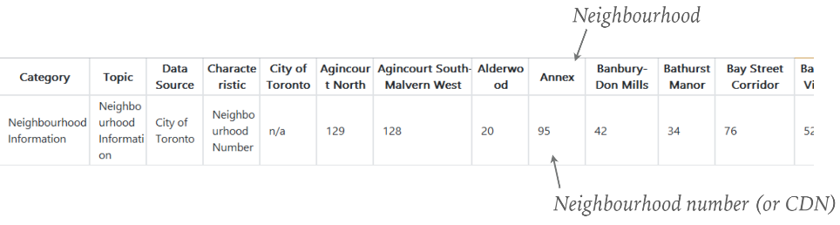
Data:
Examples of data from the dataset :
Neighborhood information data :
We can see :
We have the name of each neighborhood in each column name (starting at position 6)
The neighborhood number (also called CDN number) in the first row (starting at position 6)

Slide 7
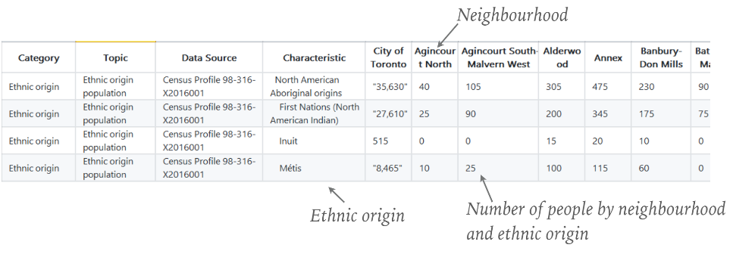
Data:
Examples of data from the dataset :
Ethnic origin data :
We can see :
We have the name of each neighborhood in each column name (starting at position 6)
We have the name of each ethnic origin in the Characteristic column
The number of people living in each neighborhood, associated to each ethnic origin name.

Slide 8
Data :
B) List of venues by neighborhood using the FoursquareAPI :
In order to obtain the list of venues, and especially the list of restaurants with the same type as the one we want to open, we are going to request FoursquareAPI with an Explore query. The documentation for the Explore query can be found here :
https://developer.foursquare.com/docs/api/venues/explore
We query FoursquareAPI supplying the neighborhood's information (coordinates calculated with the Geocoder package), the radius of scan, and the limit of number of venues we want to retrieve.
Here is an example of a place in a specific neighborhood retrieved from a FoursquareAPI call :
Link Of page :
We can see :
The place comes from the Lawrence Park South : headerLocation tag
The name of the place is Wooden Woodworking Canada Inc. : Group -> Items -> Venue -> Name tag
The category of the place is Service à domicile (English translation : Home service) : Group -> Items -> Venue -> Categories -> Name tag

Slide 9
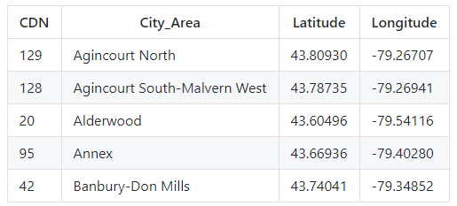
Methodology :
As we previously saw, we use the following datasets :
A list of general information about the neighborhoods (Neighborhood name, Number, and coordinates calculated using the Geocoder package)
A list of demographic data about the neighborhoods, with the number of people of each ethnic origin living in these neighborhoods.
A good way to start our analysis is to draw each neighborhood over the map of the city of Toronto, in order to check if the dataset with the list of neighborhoods is complete and covers the whole city. For that, we need each neighborhood' coordinates.
As we saw, the neighborhoods' coordinates are not available in the Neighborhood information data dataset. So we are going to retrieve them using the Geocoder package. We then store each neighborhood's coordinates into a data frame, like this :

Slide 10
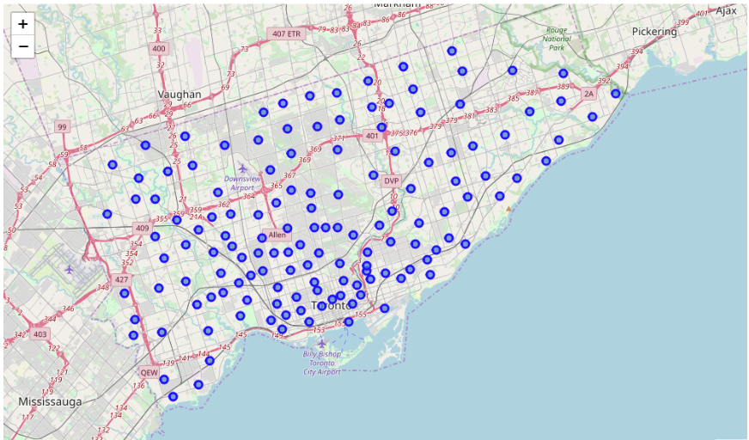
Methodology :
The map of the city is displayed using the Folium package. On this map, we draw a blue circle for each neighborhood, using the neighborhoods' coordinates. It is a good way to visualize the position of each neighborhood in our dataset. It also confirms that the different neighborhoods are well distributed within the city, and that our dataset covers the whole city (no missing neighborhood).

Slide 11
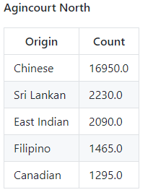
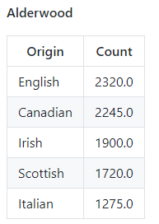
Methodology:
Once the map with the neighborhoods is displayed, we need to find out what are the top most common ethnic origins for each neighborhoods, in order to prepare our data for clustering by demographic data. We do this by counting the number of occurrences of each ethnic origin for each neighborhood, and sorting the ethnic origins by number of occurrence descending.
Here are two examples of neighborhoods, with their top 5 most common ethnic origins of habitants, sorted by count descending :
This will allow us to perform a clustering based on demographic data.

Slide 12
Machine learning algorithm:
For the clustering, we use a K-Means algorithm. I chose to use a K-Means algorithm, as it is one on the most used algorithm for unsupervised learning and clustering. It is typically used for scenarios like understanding the population demographics, market segmentation, social media trends, anomaly detection, etc... where the clusters are unknown to begin with. It is exactly our scenario, as we want to understand how the neighborhoods of Toronto are segmented, and the clusters to begin with are unknown in this situation. Also, K-Means is one of the simplest clustering algorithm to implement and to run, and is less time consuming than other, more complex algorithms.
As we can see, the number of occurrences in the demographic data is a numerical value. This means that we can directly use this data for the clustering, we don't need to use any One Hot Encoding.
In order to determine the best number of clusters for our dataset, which is the optimal K for our K-means algorithm, we are going to use the Elbow method as described here : https://blog.cambridgespark.com/how-to-determine-the-optimal-number-of-clusters-for-k-means-clustering-14f27070048f
The Elbow method is a method to find the most appropriate number of clusters in a dataset, by running several K-means algorithm and comparing the sum of squared distances of samples to the nearest cluster center. The more the sum of squared distance is, the further the data points are globally from their cluster center. But we don't have to set K too high, as if K is set to the number of data points, then each sample will form its own cluster meaning sum of squared distances equals zero, which is not a good clustering.

Slide 13
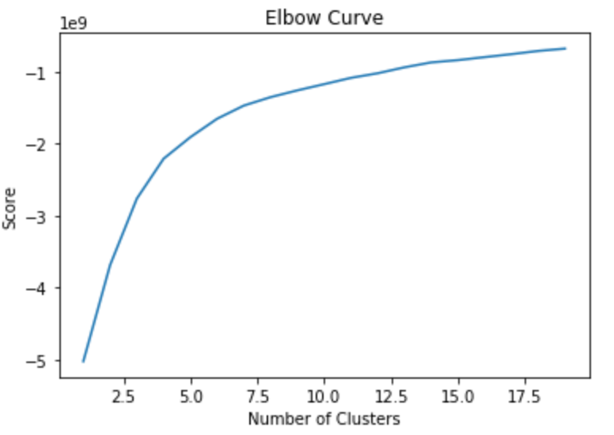
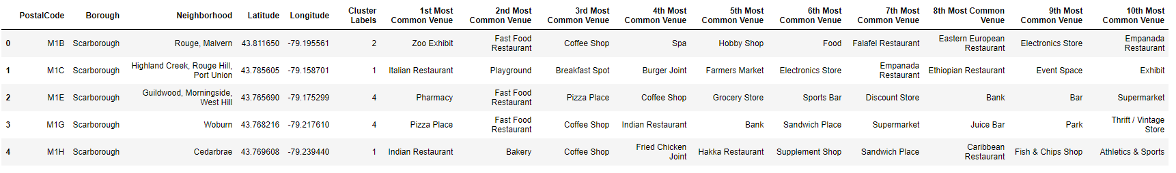
Machine learning algorithm:
We are going to use K = 5, as the elbow is highly visible for this value.
Once the clustering is done, we obtain a dataset like this (example with two neighborhoods from two different clusters) :
We have the CDN number, the name of the neighborhood, the coordinates, the cluster label obtained by the K-means algorithm, and the top most common ethnic origins by neighborhood.
Cluster

Slide 14
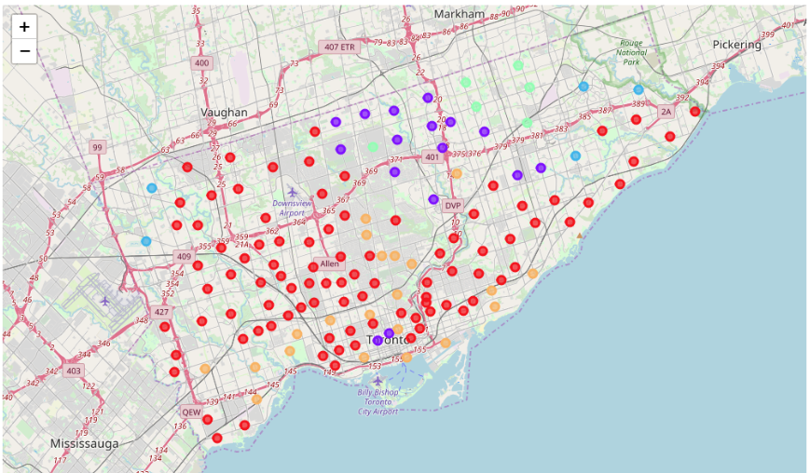
Machine learning algorithm:
We can then visualize the clusters on a Folium map. We display each neighborhood as a circle on the map, each circle will be colored according to the cluster they have been categorized into.

Slide 15
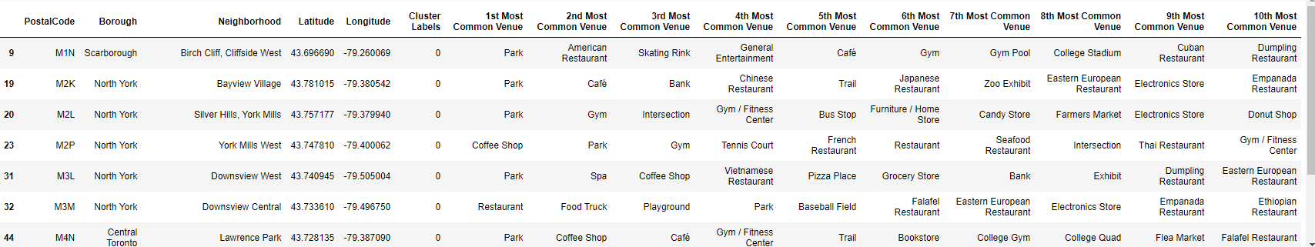
Discussion :
A) Clusters :
We obtain the following results :
Cluster 0 : European & Canadian (Red color)
The Cluster 0 regroups areas highly habited by European and Canadian people. We can see English, Italian, Portuguese, French people . Most of them are positioned in almost all the south of Toronto, and in the downtown.
For example :
This cluster would interest anyone which wants to open a European oriented restaurant, for example an Italian or a French restaurant, as it contains the neighborhoods with the strongest European tendency within their habitants.

Slide 16
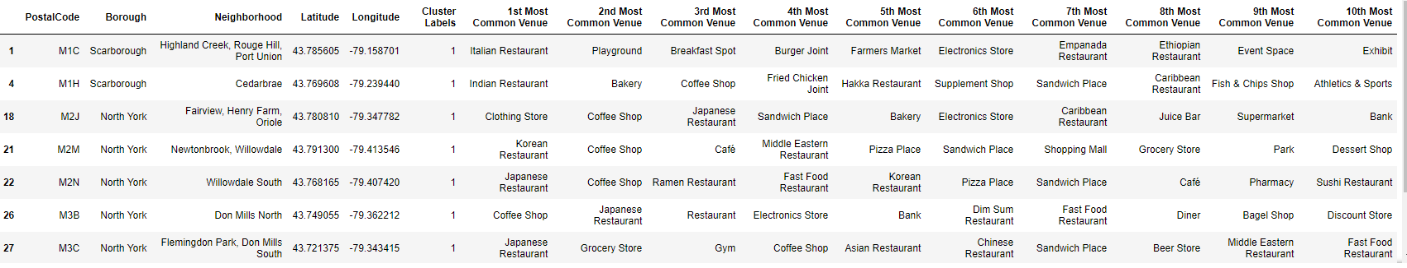
Discussion :
A) Clusters :
Cluster 1 : Asian (Purple color)
The Cluster 1 regroups areas highly habited Chinese people, and people from others countries in Asia. We can see that most of them are positioned at the north of Toronto.
For example :
This cluster would interest anyone which wants to open an Asian restaurant, for example a Chinese restaurant, as it contains the neighborhoods with the strongest Asian tendency within their habitants.

Slide 17
Discussion :
A) Clusters :
Cluster 2 : Indian (Dark green color)
The Cluster 2 concentrates areas highly habited by Indian people. We can see that these areas are located at the edges of Toronto.
For example :
This cluster would interest anyone which wants to open an Indian restaurant.

Slide 18
Discussion :
A) Clusters :
Cluster 3 : Chinese (Light green color)
The Cluster 3 also regroups areas highly habited by Asian people, the most common ethnic origin is Chinese. We can see that most of them are positioned at the north east of Toronto, next to the cluster 1. This cluster is highly similar to the cluster 1.
For example :
This cluster would interest anyone which wants to open a Chinese restaurant, or an Asian restaurant in general.

Slide 19
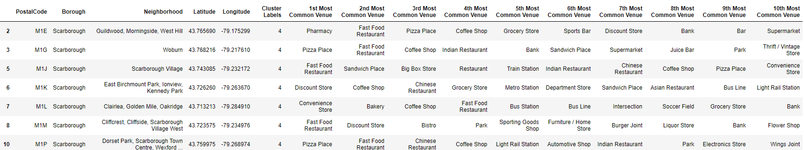
Discussion :
A) Clusters :
Cluster 4 : Irish, Scottish & English (Yellow color)
The Cluster 4 regroups areas highly habited by English, Irish, Scottish and Canadian people. We can also see that there are a lot of people from other European countries as well, such as French, German, Polish, ... Most of these neighborhoods are positioned at the south and in the downtown of Toronto.
For example :
The cluster would interest anyone which wants to open an English or Irish pub, or any UK/Ireland related type of restaurant.

Slide 20
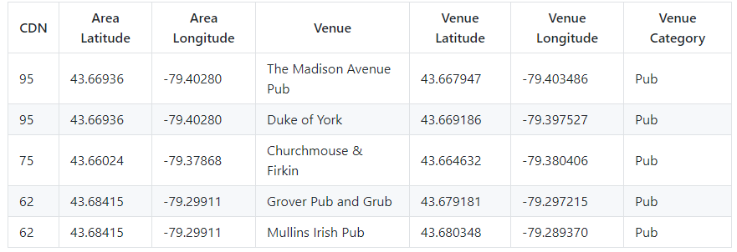
Discussion :
B) Analyze each neighborhood's competition:
Let's say we want to open an Irish pub. We are going to use the cluster 4 in order to find the best neighborhood for this will. In order to analyze the competition for each neighborhood, we are going to retrieve the list of existing venues of the type pub, in the neighborhoods categorized as cluster 4. For this task, we use FoursquareAPI.
We build a data frame as such (top 5 rows which represent 5 venues with the Pub category) :

Slide 21
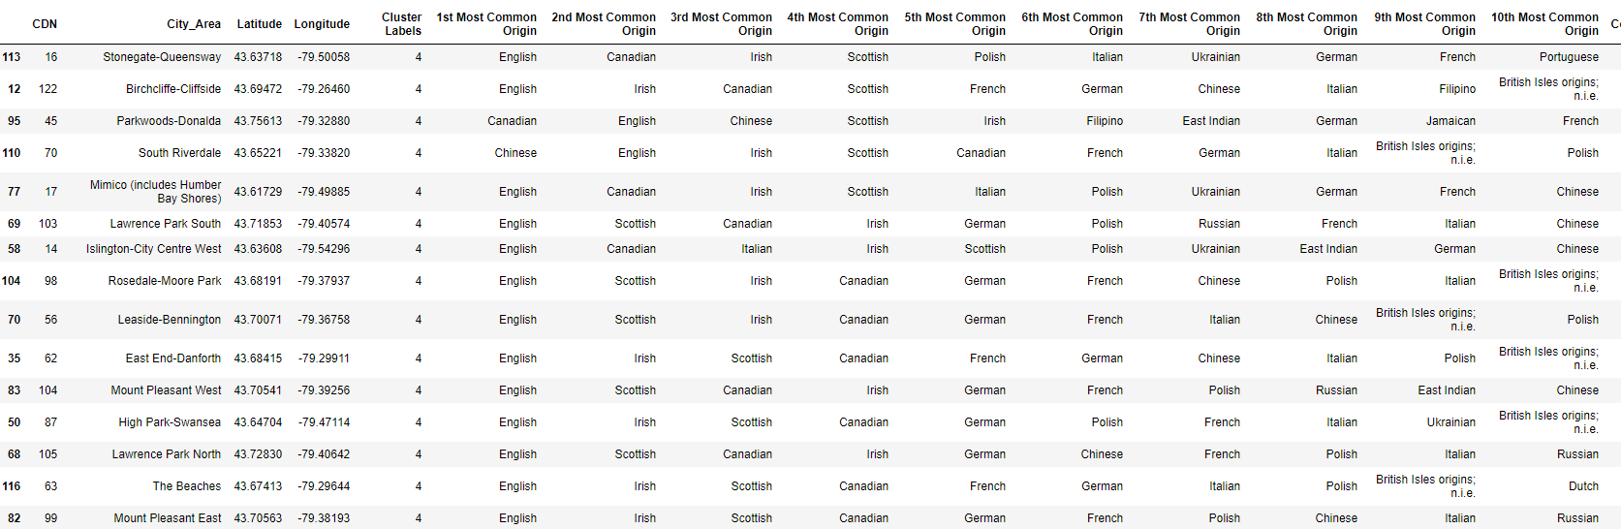
Discussion :
B) Analyze each neighborhood's competition:
We can then count the number of existing Pubs for each neighbourhood, and sort these neighborhoods by count ascending :

Slide 22
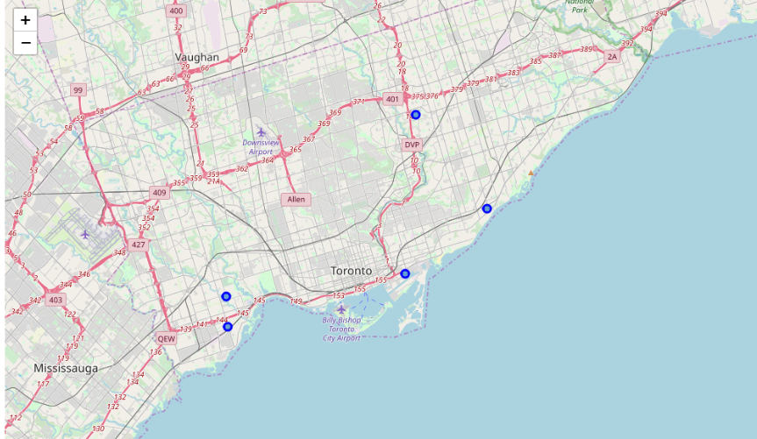
Discussion :
B) Analyze each neighborhood's competition:
We assume that the top 5 neighborhoods from this list represent the best places to open a new pub, as :
The demographic data shows that people will likely come in this kind of venue in these neighborhoods
The competition is limited in these neighborhoods
We can draw these 5 neighborhoods on the map of Toronto :

Slide 23
Conclusion :
In this project, we managed to cluster the city of Toronto using demographic data by neighborhoods. This helps us identify which neighborhoods are the most adequate for opening a new restaurant of a specific type.
Then, we managed to identify the neighborhoods with the less competition within these adequate neighborhoods, in order to optimize the performance of this new business.
Best New Business will be “Irish pub”
And Best Locations are Highlighted in Map.

